Slide 1
INTRODUCTION TO
PYTHON

Slide 2
TABLE OF CONTENT
Why Python
Applications of Python
Python and its features
Packages overview
NumPy
Pandas
Scikit Learn
Matplotlib
Seaborn
TensorFlow
Installation steps
Jupyter Notebook for Python and shortcuts

Slide 3
Python’s benevolent dictator for life
“Python is an experiment in how much freedom programmers need. Too much freedom and nobody can read another's code; too little and expressiveness is endangered.”
- Guido van Rossum
Notes:
Image source:- https://commons.wikimedia.org/wiki/File:Guido_van_Rossum_2006.jpg
Share the credit under the image. This is CC2.0

Slide 4
WHY PYTHON
Easy to understand
Free and open source
Huge community support
Robust standard libraries
Wide range of applications
Fast edit-test-debug cycle
Portable
Scalable

Slide 5
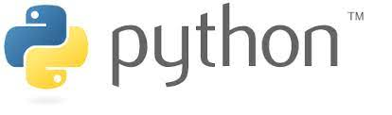
APPLICATION OF PYTHON
Software development
AI/ML & visualization
Data science & analytics
GUI
Web development
Game development
Notes:
Diagram created internally

Slide 6





APPLICATION OF PYTHON
Large section of YouTube video sharing system is written in Python.
NASA uses Python to perform many specific tasks.
Web search system uses Python.
Server & Client software of Dropbox storage use Python.
Peer to peer file sharing system started with Python.
Notes:
Logos are taken from wikimedia commons
E.g.: https://commons.wikimedia.org/wiki/File:BitTorrent_logo.svg
Good to go

Slide 7
PYTHON & ITS FEATURES
Object oriented programming
Interpreted language
High-level programming
Dynamic semantics
High-level built in data structures
Automatic garbage collection

Slide 8
PYTHON BUILT-IN DATA TYPES
Boolean
Bool
0,1,True,False
Text
Str
‘python’
“python”
Numeric
int, float, complex
10, 10.67, 10+2j
Python data types
List
[1,”A”,[2,4]]
Sequence
Tuple
(1,2,3,4)
Mapping
Dict
{“name” : “python”, ”number”:1}
Set
{1,2,3,4}
Set
Binary
b"Hello"
bytes
Notes:
Diagram created internally

Slide 9
PYTHON OPERATORS
+,-
Arithmetic operators
=, +=
Assignment operators
<,>
Relational operators
and, or
Logical operators
Is, is not
Identity operators
In, not in
Membership operators
&,^
Bitwise operators
Notes:
Diagram created internally

Slide 10
PYTHON TOKENS
Small units of the programming language
Keywords
Punctuators
Identifiers
Tokens
Operators
Literals
Notes:
Diagram created internally

Slide 11
PACKAGES OVERVIEW
A Python package usually consists of several modules.
Has Build-in modules & Open source modules.
NumPy, Pandas, Scikit Learn, Matplotlib, Seaborn, SciPy, TensorFlow, Keras, and many more.
Pandas
NumPy
Scikit Learn
Matplotlib
Seaborn
Notes:
Logo taken from wikimedia commons & Diagram created internally
Link: https://commons.wikimedia.org/wiki/File:Python_logo_and_wordmark.svg

Slide 12
OPEN SOURCE PACKAGES

Slide 13
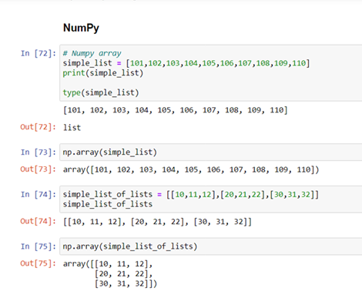
1. NumPy
Adds support for large, multi-dimensional arrays and matrices, along with a large collection of high-level mathematical functions to operate on these arrays.
Open source library
Notes:
Screenshot is taken from a personal notebook

Slide 14
2. Pandas
Mainly used for structured data operations and manipulations.
Offer powerful data processing capabilities, open source library.
Reading various forms Datasets (CSV, Excel, etc)
Reshaping Datasets
Manipulating the data
Splitting and modifying the Datasets
Pandas Capabilities
Merging, concatenating Datasets
Handling missing data
Grouping and filtering data
Indexing and Ranking
Notes:
Diagram created internally

Slide 15
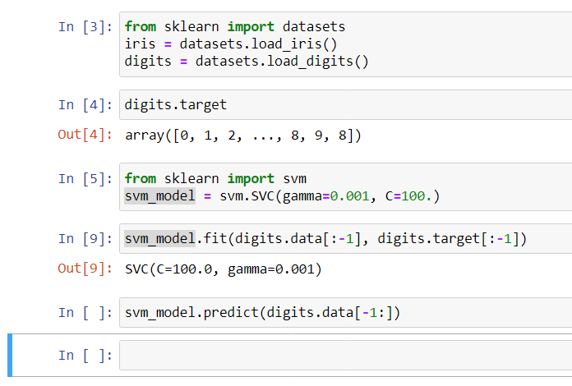
3. Scikit Learn
Contains a huge number of Machine Learning algorithms and other key performance-related libraries
Regression
Classification
Clustering
Model Selection
Dimensionality reduction and many more
Notes:
Screenshot is taken from a personal notebook

Slide 16
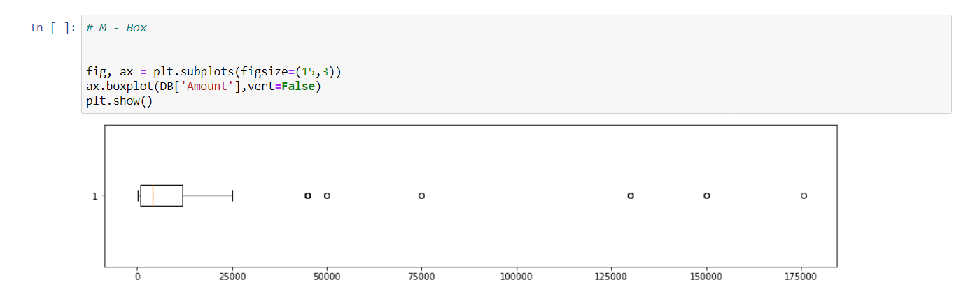
4. Matplotlib
Plotting library for the Python programming language and its numerical mathematics extension NumPy.
Most of the Matplotlib utilities lies under “pyplot” submodule.
Notes:
Screenshot is taken from a personal notebook

Slide 17
5. Seaborn
Visualization library for statistical graphics plotting in Python.
Built on the top of Matplotlib.
Closely integrated to the data structures from Pandas.
Seaborn divides plot into the below categories
Relational plots
Categorical plots
Distribution plots
Regression plots
Matrix plots
Multi plot grids
Examples: displot, boxplot, countplot, etc.

Slide 18
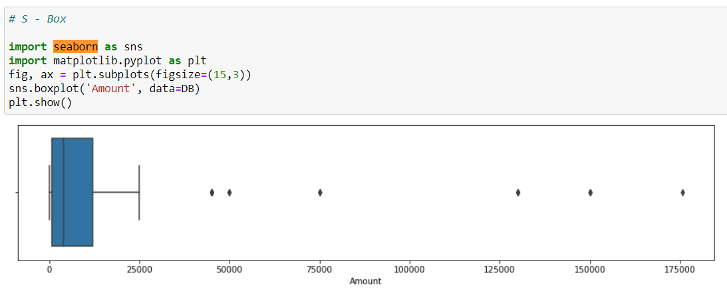
5. Seaborn
Notes:
Screenshot is taken from a personal notebook

Slide 19



PYTHON INSTALLATION – Need for Editor
PYTHON IDEs (Integrated Development Environment)
A text editor helps to automate the tasks and enhance the productivity and efficiency of the developer.
Why IDE ? :
Provides an editor designed to handle code (with, for example, syntax highlighting and auto-completion).
Provides build, execution, and debugging tools.
Some form of source control.
Jupyter
IDLE
Notes:
Logos are taken from wikimedia commons
Link: https://commons.wikimedia.org/wiki/File:Python_logo_and_wordmark.svg

Slide 20
PYTHON INSTALLATION – ANACONDA DISTRIBUTION
Anaconda distribution comes with over 250 packages automatically installed, and over 7,500 additional open-source packages can be installed from PyPI as well as the conda package.
Anaconda Individual Edition links:
1. Anaconda 5.2 For Linux Installer - https://www.anaconda.com/download/#linux 2. Anaconda 5.2 For macOS Installer - https://www.anaconda.com/download/#macos 3. Anaconda 5.2 For Windows Installer - https://www.anaconda.com/download/#windows (You need to download the version compatible with your OS.)

Slide 21
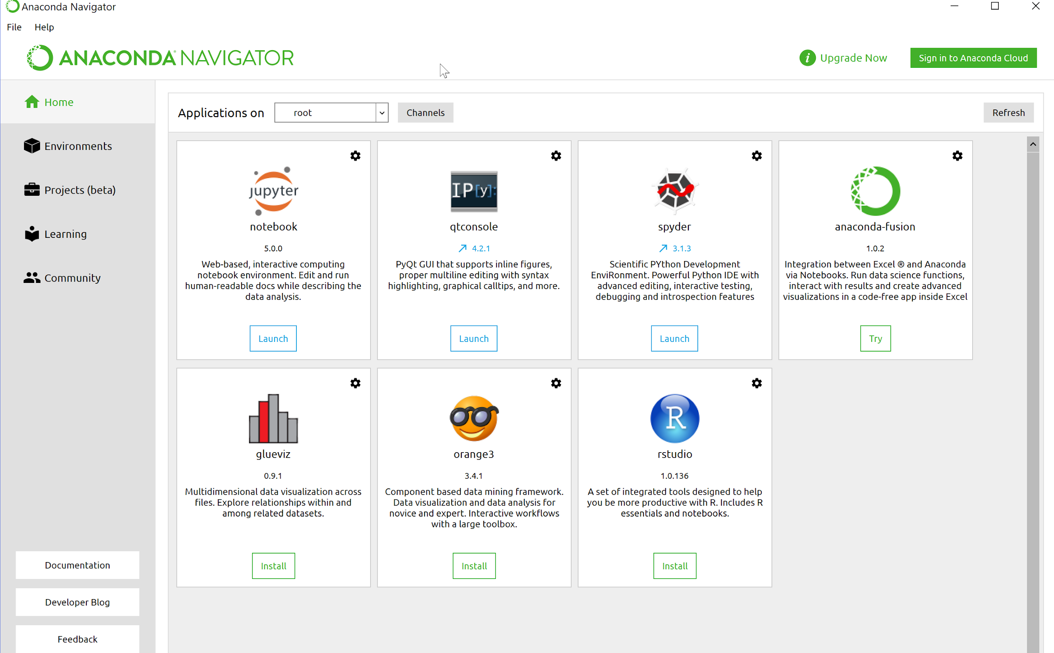
ANACONDA NAVIGATOR
Notes:
Screenshot is taken from a personal system

Slide 22

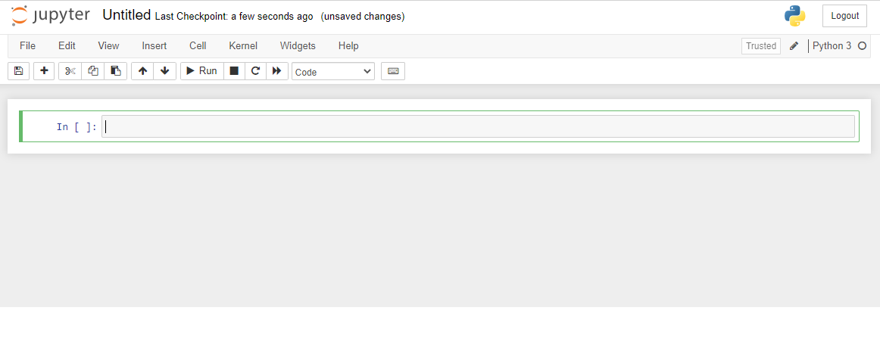
JUPYTER NOTEBOOK FOR PYTHON
An open source web application that you can use to create and share documents that contain live code, equations, visualizations, and text.
Anaconda navigator comes with Jupyter notebook.
Notes:
Screenshot is taken from a personal notebook

Slide 23
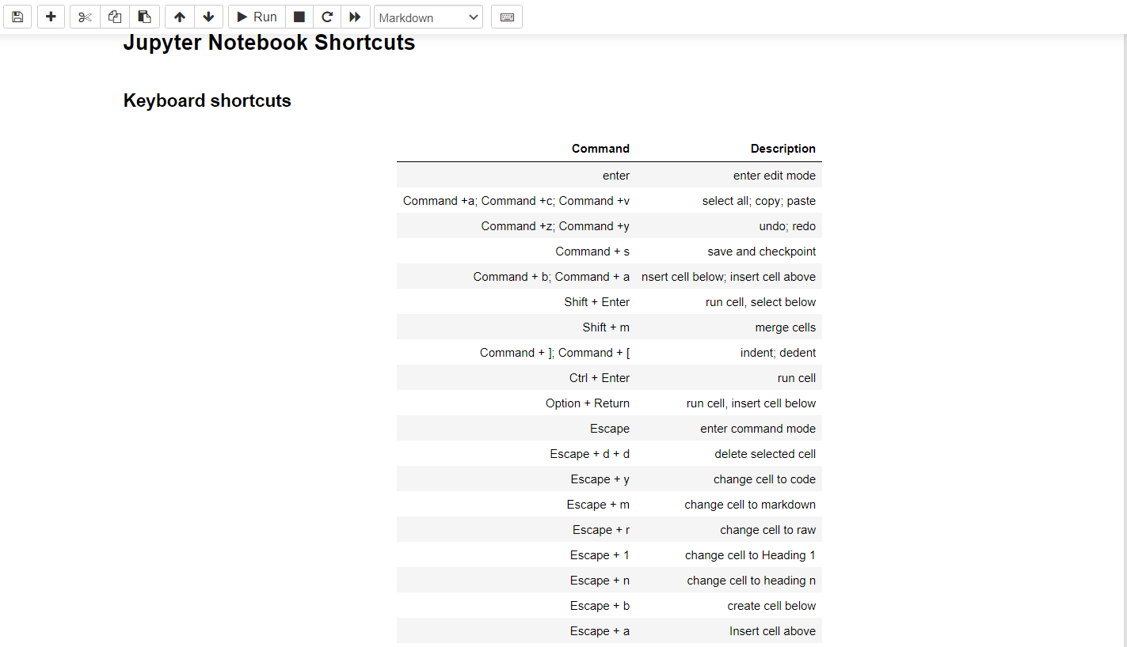
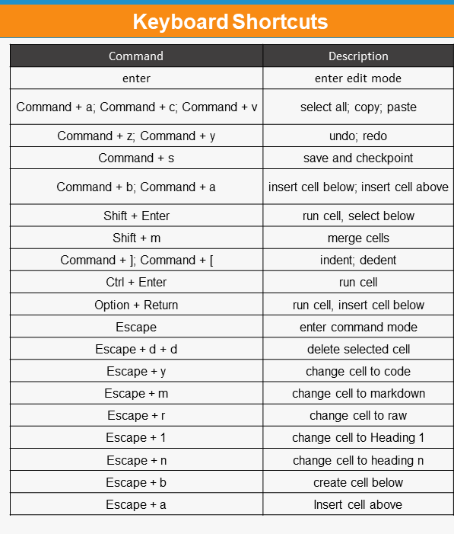
JUPYTER NOTEBOOK SHORTCUTS
Notes:
Screenshot is taken from a personal notebook

Slide 24
SUMMARY
Discussed need for python
Basic features of python
Variables and operators in python
Packages in Python
Editor and Jupyter

Slide 25
Hands-On

